Slide 1
CLUSTERING
with Python Scikit-Learn
March 2023

Slide 2
Overview
CLASSIFICATION
FEATURES
LABELS
MODEL
(UNTRAINED)
PARAMETERS

Slide 3
Overview
CLASSIFICATION
PREDICTED LABELS
TEST SET
MODEL
(TRAINED)
FEATURES

Slide 4
Overview
UNSUPERVISED LEARNING
FEATURES
LABELS
MODEL
?
What if there are no labels?

Slide 5
Overview
CLUSTERING
X | Y
CLUSTERING MODEL
Y
FEATURES
X
PARAMETERS

Slide 6
Using a Clustering Model
Model
Source: from scratch or import from an existing package (e.g. sklearn)
Input: Training Set
Features
Parameters
e.g. : for kMeans, k is a parameter

Slide 7


Clustering Overview
Import the model from a package (sklearn)
Create an instance of the model
Train the model (often using the fit() function)
…

Slide 8
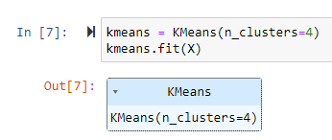
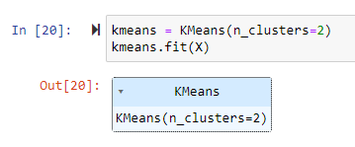
Clustering Overview
You can create multiple models with different parameters
k = 4
k = 2

Slide 9
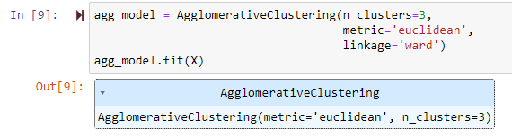
Hierarchical Clustering
Scikit Learn: AgglomerativeClustering
…

Slide 10
KMeans
Scikit Learn: KMeans
…

Slide 11
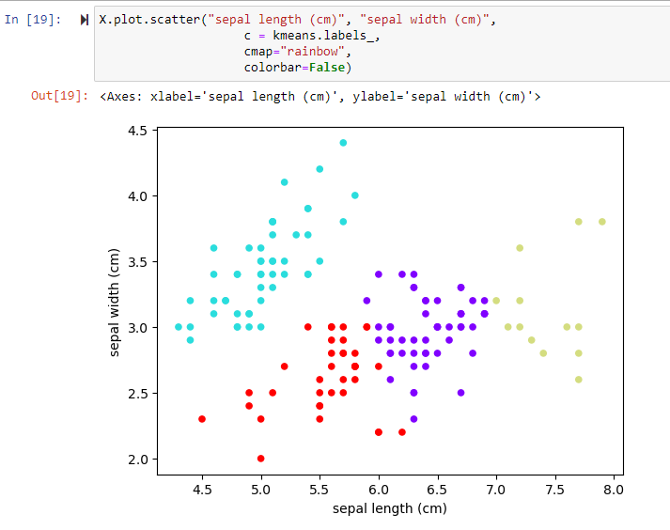
Scatter Plot

Slide 12
Scatter Plot
dataframe.plot.scatter( “feature1”, “feature2”,
c = model.labels_,
cmap=“rainbow”, colorbar=False)

Slide 13
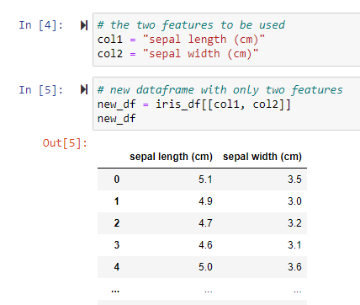
Clustering Overview
Note: we can cluster based on more than just two features!
- In our example, we only use two features
from the iris dataset:
sepal length (cm)
sepal width (cm)
- Hard to visualize more than 2 features

Slide 14
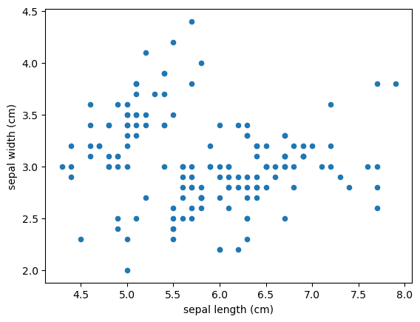
Clustering Overview
Note: we can cluster based on more than just two features!
- In our example, we only use two features
from the iris dataset:
sepal length (cm)
sepal width (cm)
- Hard to visualize more than 2 features

Slide 15
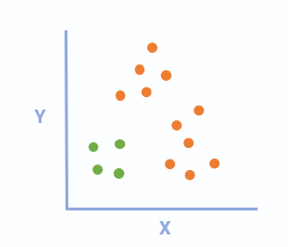
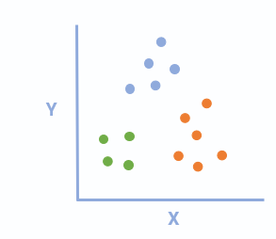
Overview
CLUSTERING
k = 2
How do we choose the number of clusters to use?
k = 3

Slide 16
Hierarchical Clustering
Visualize through dendrograms then make estimates from there

Slide 17
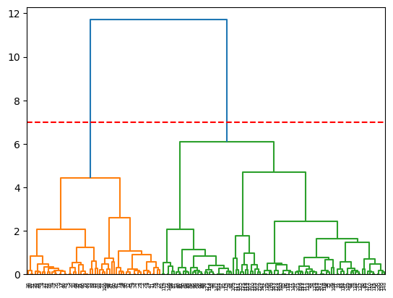
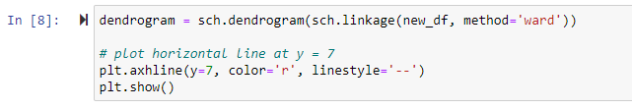
Hierarchical Clustering
Dendrogram Visualization
Draw a horizontal line
Number of clusters: lines that intersect with the horizontal line

Slide 18
Hierarchical Clustering
Dendrogram Visualization
Horizontal line: y = 7
Number of clusters: 2

Slide 19
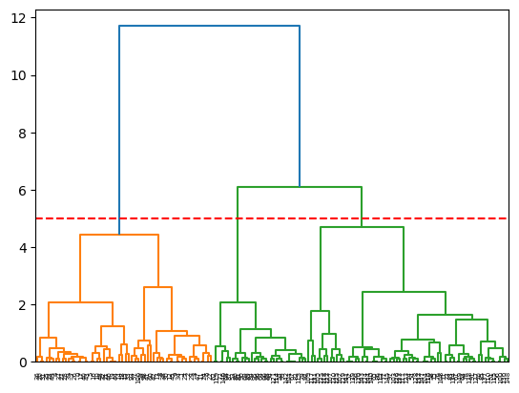
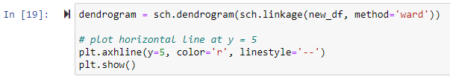
Hierarchical Clustering
Dendrogram Visualization
Horizontal line: y = 5
Number of clusters: 3

Slide 20
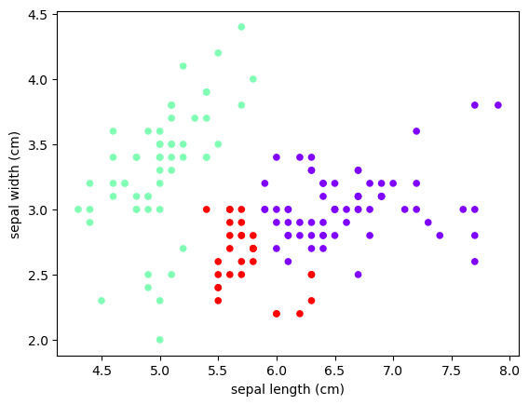
Hierarchical Clustering
Dendrogram Visualization
Horizontal line: y = 5
Number of clusters: 3

Slide 21
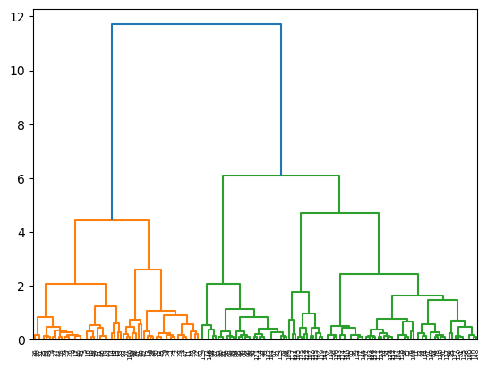
Hierarchical Clustering
Dendrogram Visualization
Number of clusters: 4
y = ?
(where will the horizontal line be?)

Slide 22
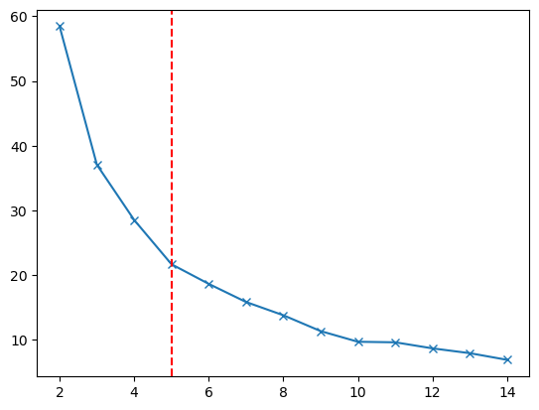
KMeans
Methods to determine K:
Silhouette Score
Elbow Method

Slide 23
KMeans: Silhouette Score
For each k in a range of k values:
Create a kMeans model
Fit the model with dataset
Get the instances’ cluster labels
Get the silhouette score
Get the k with the highest silhouette score

Slide 24


KMeans: Silhouette Score
For each k in a range of k values:
Create a kMeans model
Fit the model with dataset
Get the instances’ cluster labels
Get the silhouette score
Get the k with the highest silhouette score

Slide 25
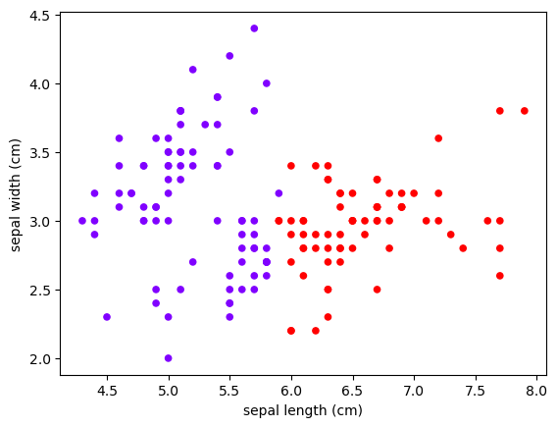
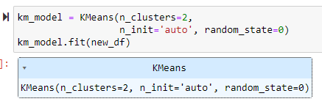
KMeans: Silhouette Score

Slide 26
KMeans: Elbow Method
For each k in a range of k values:
Create a kmeans model
Fit the model with dataset
Get and store inertia in a list
Plot the inertia values and estimate which k starts the “bend” (elbow) in the graph

Slide 27

KMeans: Elbow Method
For each k in a range of k values:
Create a kmeans model
Fit the model with dataset
Get and store inertia in a list
Plot the inertia values and estimate which k starts the “bend” (elbow) in the graph

Slide 28
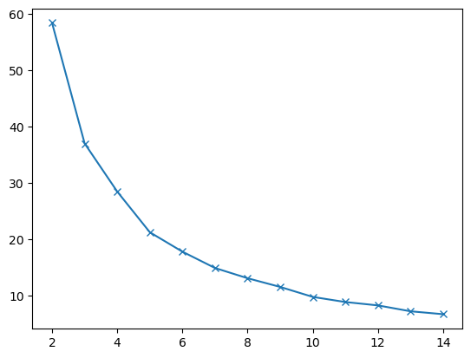
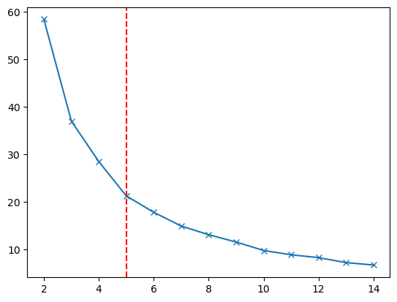
KMeans: Elbow Method
Estimate from elbow method: k = 5

Slide 29
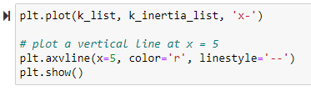
KMeans: Elbow Method
Estimate from elbow method: k = 5

Slide 30
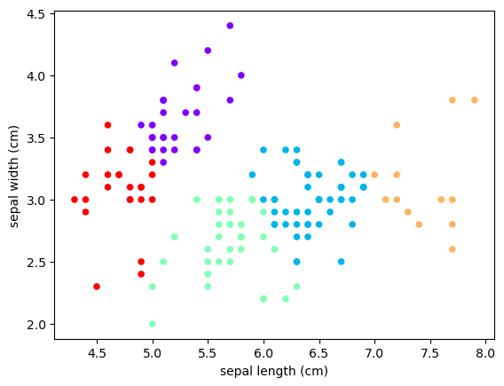
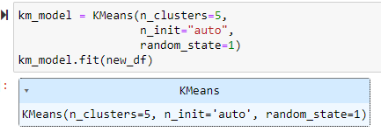
KMeans: Elbow Method
Estimate from elbow method: k = 5

Slide 31
Overview
Iris Clustering Jupyter Notebook Outline:
Prepare dataset (use two features: sepal length and sepal width)
Hierarchical clustering
Visualize dendrogram to get number of clusters
Use Agglomerative Clustering and plot results
KMeans
Use KMeans for best k based on Silhouette score and plot results
Demonstrate elbow method, use KMeans, and plot results

